Slide 1
TBD: a good title?
Agnes Salanki
R-Ladies London
24th April 2018

Slide 2
Analyst and theatre enthusiast at the same time
By day:
Data analyst, crunching numbers
By night:
Theatre enthusiast

Slide 3
How to choose plays?
You decide when you go home
You visit the webpage of your favourite theatre
You book a ticket if there are still seats available
Program for the next month is available on the 15th of the previous month
Question: what are the plays I have a chance to book?
Data-driven approach: trying to figure out how quickly individual plays will get sold out, based on the “features” of the plays.
Disclaimer: you will unable to use this information in London.. TODO: screenshot

Slide 4
Analysis workflow
Data collection
Feature creation
Model building
Model interpretation

Slide 5
Data collection with rvest

Slide 6

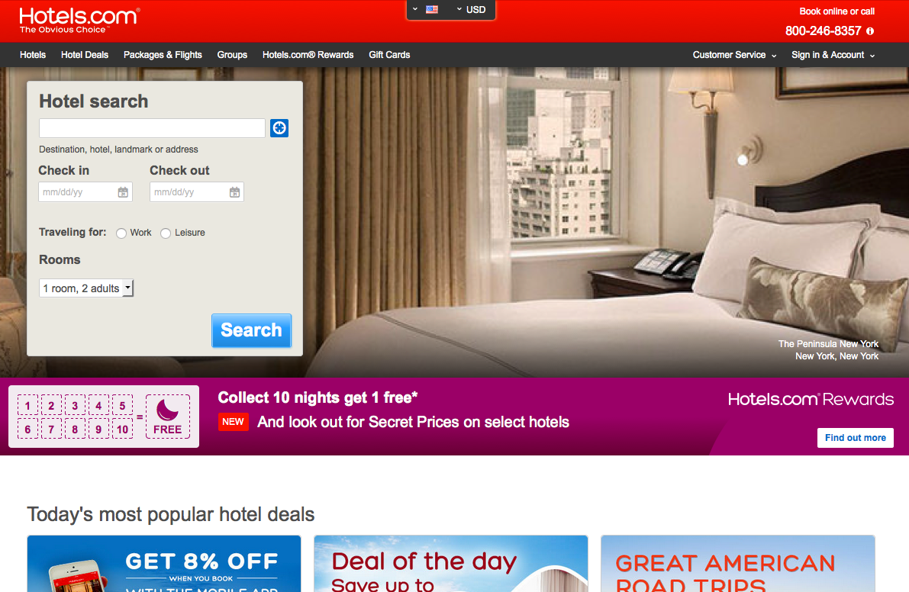
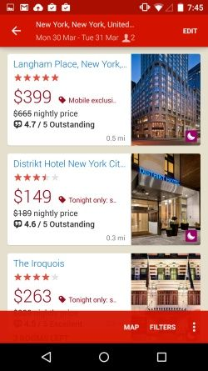
Input data set
# visits, # bookings & the revenue they generated
seven territories where the travelers originate from (the US, the UK, Australia, Brazil, Norway, Hong Kong & South Korea)
Booking information is segmented across
Destination country
Booking window (# days between booking and check-in)
Date (November in 2014 and in 2015)
Platform: Desktop, Mobile App and Mobile Web
What we are interested in:
Key drivers of mobile experience
Where opportunities in mobile may lie

Slide 7
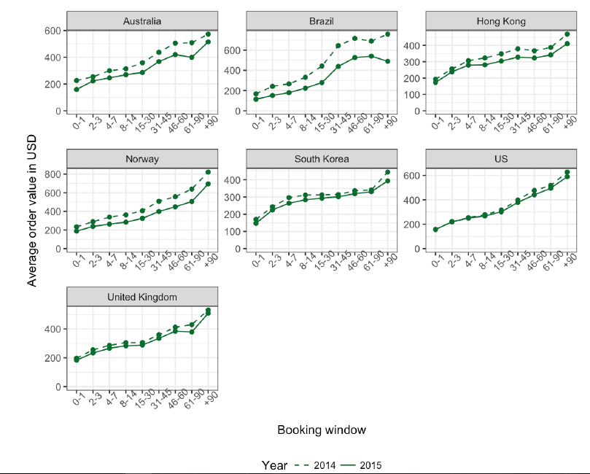
General observations: booking window and AOV
The average order value (AOV, total revenue / # bookings) of the bookings correlates positively with the length of the booking window
Metadata (e.g. length of the trip, type and size of the room)?
last minute travellers alone (e.g. businessmen looking for cheap single rooms for one night) vs.
those who book weeks ahead (e.g. families looking for comfort during a long summer holiday)?

Slide 8
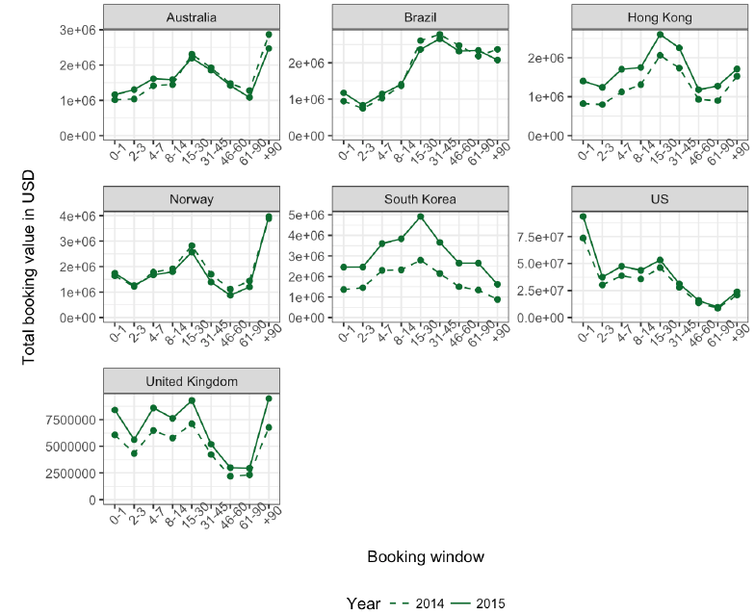
General observations: increasing popularity, decreasing AOV
Increased number of bookings + stable AOV → increasing revenue
the US, the UK, South Korea and Hong Kong
Increased number of bookings everywhere:
Increased popularity?
Increased trust?

Slide 9
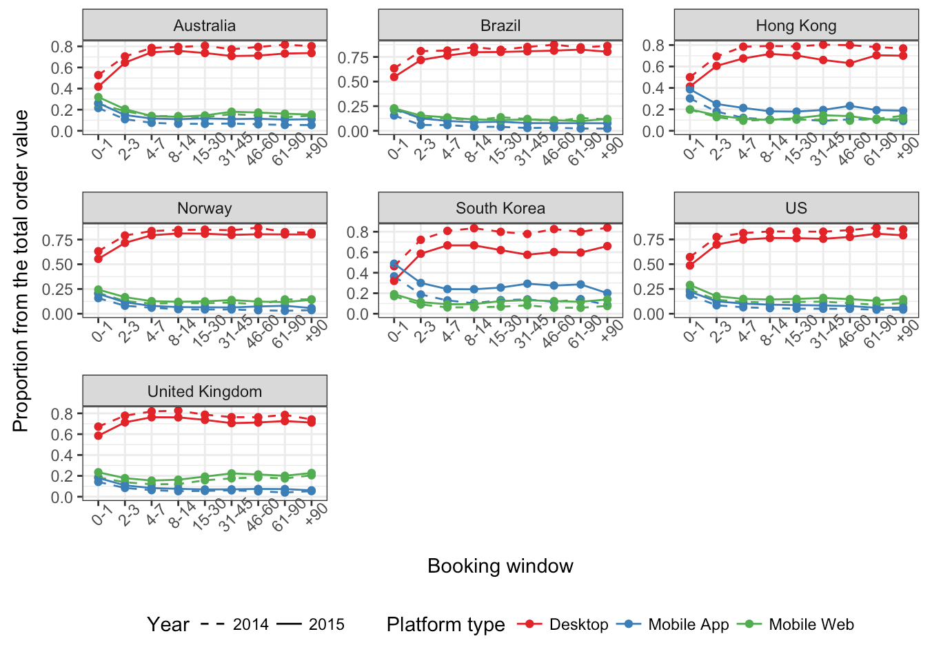
Mobile experience — rather for last minute purchases?
Independently from the source or the destination country, mobile bookings dominate the short booking window reservations.
The mobile application is extremely popular in South Korea and Hong Kong (in both years), everywhere else the mobile web usage still dominates
Mobile dominates the holidays → successful marketing campaign targeting mobile users?

Slide 10
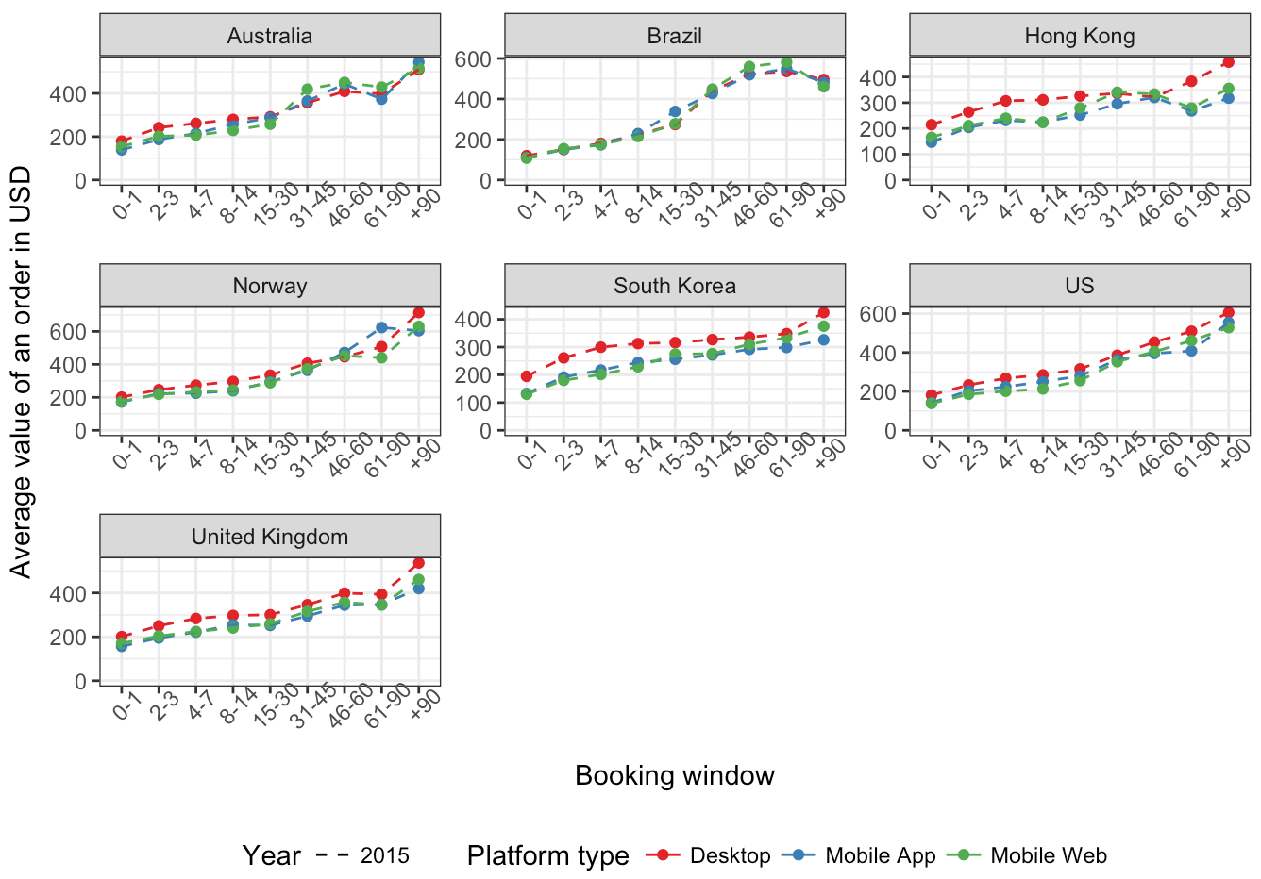
Mobile experience — for discounts and saving?
Independently from the booking window, the AOV on mobile platforms is lower than on desktop. The difference is the largest in the app-dominated countries.

Slide 11
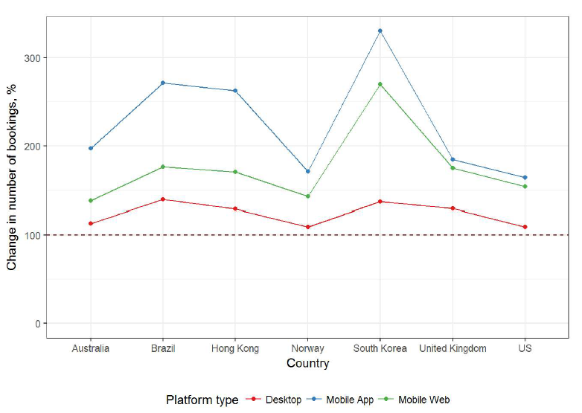
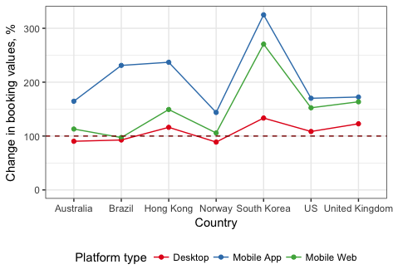
Mobile experience —
shifting towards the mobile app?
The mobile application platform showed the largest relative increase in number of bookings
To be successful, the revenue originating from Desktop should stay stable.

Slide 12
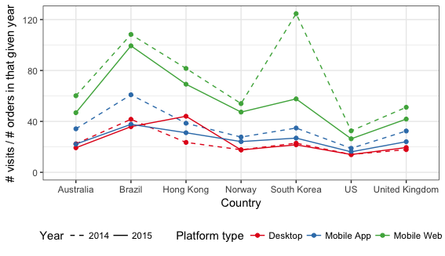
Mobile experience — for other features than booking?
The average # visits / # orders is much higher for the mobile web than for desktop or the app
Brazilia is extreme: they need ~100 visits to close a successful transaction
What do people otherwise use their device for?
One for browsing, searching and decision making
And another one for making the actual purchase, especially if it is about a large amount of money?

Slide 13
Summary
With increasing number of mobile devices per person, the traffic and the number of bookings have increased recently
Mobile web for browsing and
Mobile application for maintaining reservations?
Mobile is an extremely popular platform to book trips with short booking windows
A powerful tool e.g. in the US and in the UK, where short booking windows dominate the traffic
We should target businessmen?
Trips booked on mobile usually provide a lower AOV, still can increase
The general trust in the hotels.com brand and with it,
Revenue (maybe on other platforms as well).
Secret recipe to increase revenue: keep up the good work on Desktop + provide good last minute recommendations
Quality of mobile web experience should be investigated (the # visits / # bookings decreased in South Korea, maybe this is a symptom)

Slide 14
Summary
With increasing number of mobile devices per person, the traffic and the number of bookings have increased recently.
Mobile web for browsing and
Mobile application for maintaining reservations?
Mobile is an extremely popular platform to book trips with short booking windows.
These trips usually provide a lower AOV but can increase
General trust in the hotels.com brand and
Eventually revenue dramatically (maybe on other platforms as well).
Quality of mobile web experience should be investigated, it produces lower conversion rates than the other two platforms
What other information could help by profiling those users who convert on mobile?
Popularity of mobile devices in the source country — e.g. trips with 90+ day booking windows booked on mobile could be only a good proxy for a general trend of increasing mobile usage
Cross-platform usage and feature segmentation —people might use different devices for different purposes. E.g., people may install the application rather to manage and cancel already existing bookings than to create new ones.
Returning visitors — people might try to use their mobile devices for making reservations; we should also investigate their general satisfaction and how loyal they become.

Slide 15
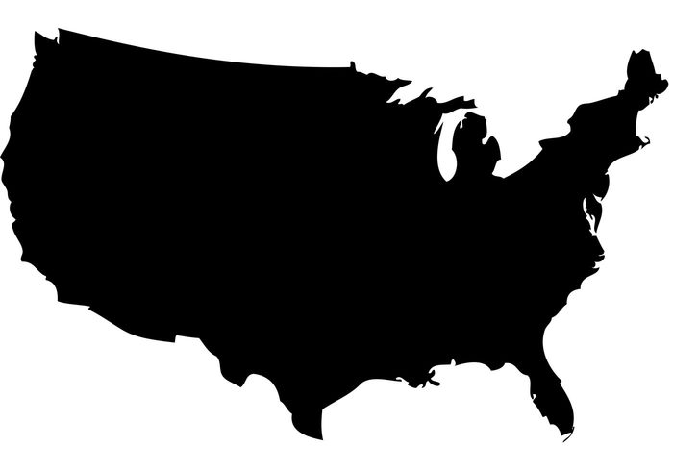

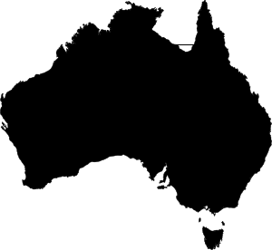

What influence the mobile had on each country?
US: 80% of revenue comes from within-country trips, short booking windows dominate the traffic → ideal market for the mobile users, especially because people seem to have a general “trust” in the brand (on average, each 20th visit creates a new booking).
Brazil: Trips with longer booking windows (> 2 weeks) dominate the revenue. Performance of the mobile app is promising in this segment, however, the low conversion rate on mobile web is concerning → the mobile web experience should be investigated.
Australia: Longer (> 2 weeks) booking windows dominate and in these categories, the total revenue has slightly decreased in 2015, mostly because of the reduction in revenue coming from the desktop experience.
UK: important revenue source with great conversion, people with short booking window are ideal users.

Slide 16



What influence the mobile had on each country?
Norway: has a similar pattern as Australia: the site is used mostly for holiday planning (90+ booking window) here and the revenue lost in this segment on desktops were not replaced on mobile. However, conversion rates are promising → increased effort should be placed on marketing of new visitors.
Hong Kong: people are obviously shifting towards the mobile app, generating all together a 35% relative increase in revenue (even with a large difference between AOVs of desktop and mobile). The conversion rate slightly dropped on desktop — maybe the site is getting popular and gets more visits but people do not have a general trust in it yet and do not end up purchasing?
South Korea: 72% increase in the total generated revenue and exceptional improvement in mobile web conversion rate. It might be a sign of getting more trust in the hotels.com brand — maybe mobile users should be targeted for first time visitors and their loyalty will increase revenue on other platforms as well.

Slide 17
General observations
Influence of the booking window:
The average order value (AOV, total revenue / # bookings) of the bookings correlates positively with the length of the booking window
To explain this, metadata (e.g. length of the trip, type and size of the room) of bookings should be analyzed. It is possible that those people who book their hotel room in the last minute are travelling alone with entirely different needs (e.g. businessmen looking for cheap single rooms for one night) than those who book weeks ahead (e.g. families looking for comfort during a long summer holiday).
Increasing popularity, decreasing AOV:
The AOV of the trips decreased in each country in 2015. The US, the UK, South Korea and Hong Kong still produced positive revenue difference because of the increased number of bookings.
Single and multi destination countries:
Single destination countries: there are only a few very popular trip destinations (usually the home country and the US), producing the majority of the revenue. E.g. Australia, Brazil, the UK and the US.
Multi destination countries: the revenue distribution of countries is much more uniform, even the most popular destination country provides 20% of the revenue only. E.g. Hong Kong, Norway, South Korea

